Slide 1
Information Security Policy
Protection of information and systems from unauthorized access and use in order to provide confidentiality, integrity, and availability.

Slide 2
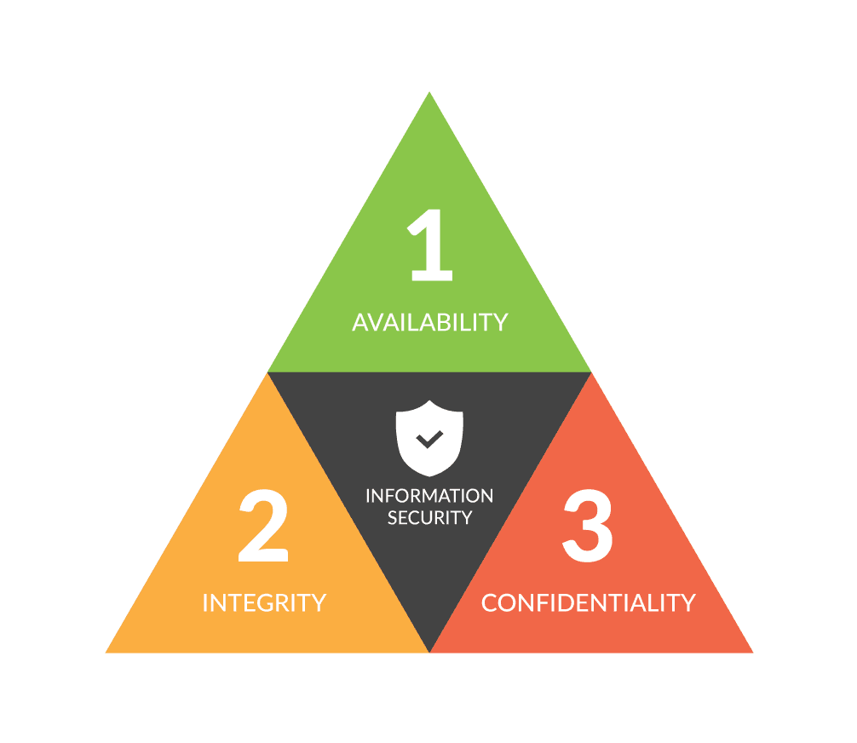
CIA Triad
Confidentiality ensures data is hidden and protected. Only visible to authorized users.
Integrity assurance of accuracy and completeness of data and that it has not been modified or omitted.
Data is available when required.

Slide 3
What is the purpose of Information Security Policy?
Information and systems are used by the company to deliver value to our customers and business partners. As such the information has value and must be protected in accordance with its sensitivity.
This policy outlines the expectations and behaviors of the organization to protect those systems, applications, and information confidentiality, integrity, and availability.
This policies approach is to comprehensively provide the full scope of policy and delivering sound information to the organization.

Slide 4
Scope
This policy applies to all staff at [Company] and its subsidiaries, to include any third-party staff contracted or providing services on behalf of [Company].
This policy applies to all systems, applications, and data within the [Company] business.

Slide 5
Access Control
Any access granted to [Company] systems, applications, and data shall require appropriate approval.
All access systems, applications, and data shall be documented and reviewed for validity on management approved frequency.
Account access to systems, applications, and data shall be removed when no longer appropriate on demand, or as discovered during review.
User account types shall be appropriate for the user access required (i.e. General user, privileged user, third party).

Slide 6
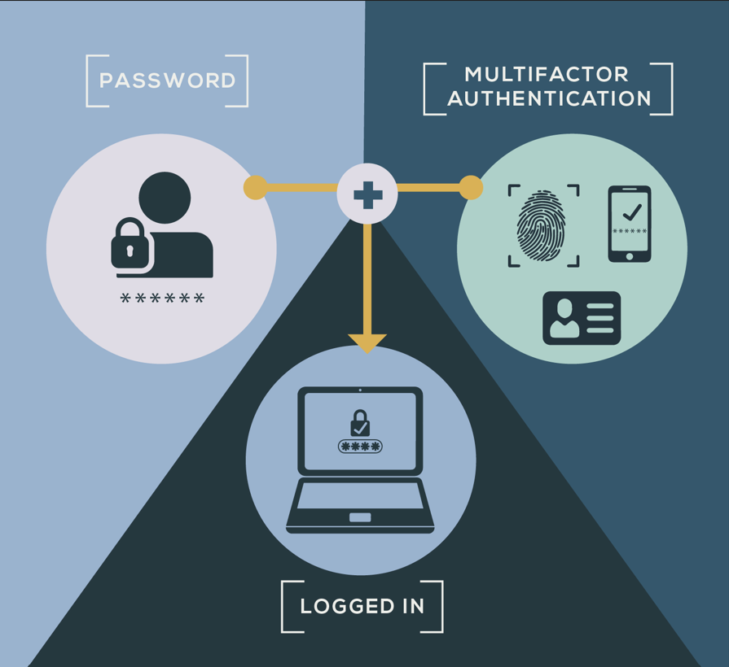
Authentication
All access to organizational systems, applications, and data that is accessible via the internet (i.e. internet-facing systems) shall require multi-factor authentication.
All mobile devices (i.e. tablets, mobile phones) shall have a authentication mechanism to unlock and access the device.
Shared user accounts shall be explicitly approved for use by management on a case-by-case basis.

Slide 7
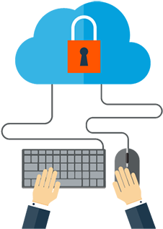
Remote Access
Remote access shall be allowed using management-approved remote access solutions.
Third-party access shall be reviewed and approved.
Third-party access shall require a member of [Company/Organization] to explicitly authorize or approve the access on-demand.

Slide 8
Non-Compliance
Any individuals that this policy applies to are required to be in full compliance towards. Non-compliance with [Company] policy will result in appropriate management-guided sanctions.

Slide 9
Management Commitment and Authority
This policy is supported and approved by [name/role]. This is the published information security policy effective [publish date].
[name/role]

Slide 10
Review Schedule
This policy shall be reviewed and updated in accordance with management defined frequency and disseminated to all applicable users as updates occur.

